Slide 1
Data Transfer Between Regions
Nakul Bajaj

Slide 2
Why?
Regulation
Data Governance
Business Strategy
Multi Cloud
Application Architecture
Costs
Latency

Slide 3
How?
Bigquery to bigquery? -> Is this possible?
Bigquery Console Link
Bq command line tool
Api
Client Libraries

Slide 4
Considerations
Data Volume
Tables
Total Size (>50 TB?) Export Quota Load Quota
Data Metadata
Schema
Labels
Partitions
Source (or Data Landing Zone)
Google Cloud Storage a.k.a GCS
Bigquery
Costs
Egress Charges ($0.18 per GB) Egress charges

Slide 5
Challenges
Too many tables
Constantly maintain check which I have transferred
Manual intervention
Data format
CSV (what if a single row gets corrupted or missing information)
Json (bulkier than others)
AVRO (data type formats) avro data type
Heavy GCP bill and Data Limit
Is compression available
Daily quota expired
What is the downtime
Dev work impact
Customer impact

Slide 6
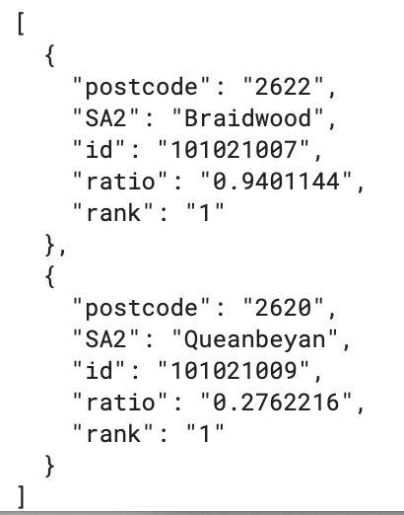
Good Practices and Lessons Learned
Automate where possible
With manual chance of human error
Build a config
You have metadata if notebook dies
Go lean
Try your script with a single table
Not too lean
Test extraction and reload of biggest table in the same region
Json over csv and avro
Heavy but less prone to errors
Compress your data
Be aware of the limit

Slide 7
Finally
Build tooling for your next run
What if you have to move data once again
What if someone else have to do this once again
Communicate a lot
Ask if you don’t know
Ask again if you are unsure

Slide 8
Small Test
Use UI to extract -> Gsutil -> UI to upload
Lets try a script (Prerequisites: python 3.7, bq and gsutil command line tool)
Run: git clone https://gitlab.theory.run/anzinsto/airflow-docker-kubernetes.git
Run: cd airflow-docker-kubernetes/bigqueryTransferExample/
Run: git checkout feature/CUS-1004-add-data-transfer-utility
Virtual env run commands:
pip install virtualenv
python –m venv virtual
virtual/bin/pip install –r requirements.txt
Explore config.py and script.py. We are moving two tables from eu to au region.
Run script.py
virtual/bin/python script.py
Clean up after run. Delete tables in au region, clean eu and au bucket where you have the data

Slide 9
Conclusion
Bq table in EU
Extract table to GCS in EU
Copy table to GCS AU
Import table in Bq AU region
Cannot use bigquery to bigquery cross region transfer
Use GCS to move data across regions
Use json over csv’s (a single comma in a csv column can corrupt the file or instead use pipe or tab as separators if columns don’t have these characters)
Use compression to reduce egress charges
Go lean but not that lean, do a test in same region on the largest table
Be aware of quotas and strategize data movement
Use google documentation and code examples, don’t go build on your own at first
Automate if more than one-two tables

Slide 10
Thank you
https://drive.google.com/file/d/1w9kU0ofm2X7Krk9v3MIPIuazq-naTol3/view

